Slide 1
Trees
3.1

Slide 2
Tree
Non-linear data structure
Used to represent hierarchical relationship among several data items

Slide 3
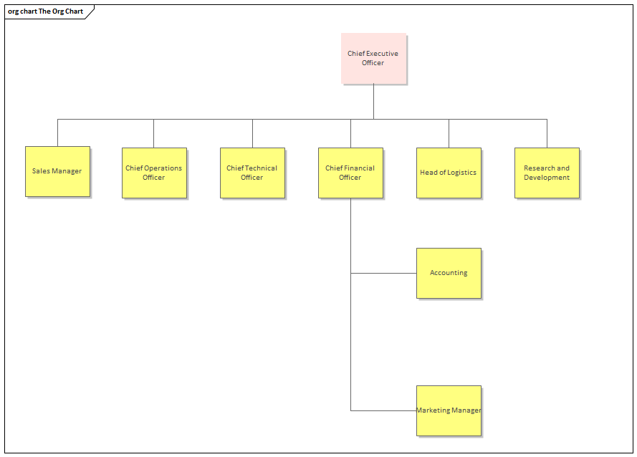
Tree
Represents Hierarchy
For eg- The organization structure of an Corporation

Slide 4
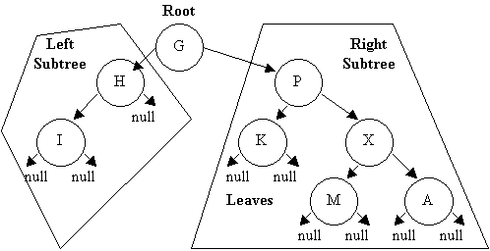
Tree
Characteristics:
There is a special data item called root of the tree
Remaining data items are partitioned into number of mutually exclusive subsets , each of which is itself a tree, called subtrees

Slide 5
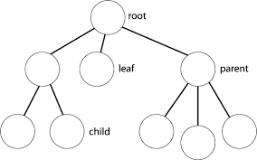
Tree
Basic Terminology-
Root-
Special Node in a tree structure.
Entire tree is referenced through it.
First in the hierarchal arrangement

Slide 6
Tree
Basic Terminology-
Node-
Each data item in a tree.
Specifies the data and links to other data items

Slide 7
Tree
Basic Terminology-
Parent
Immediate predecessor of a node
Child
Immediate successor of a node
Siblings-
Nodes with the same parent

Slide 8
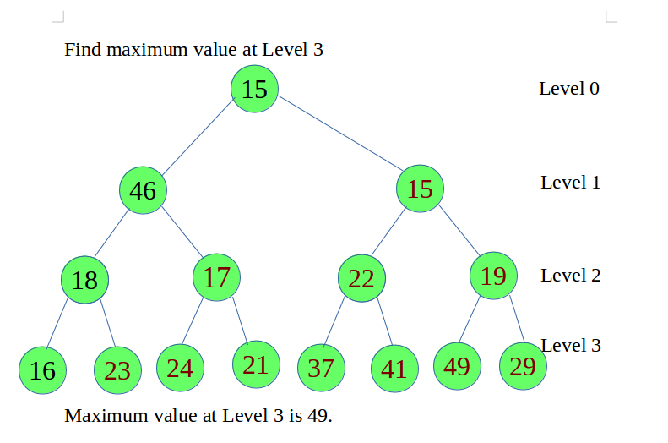
Tree
Basic Terminology-
Depth/Level-
Root Node is always at Level 0
Its immediate successor are Level 1,
Their Successor at level 2 and so on
If a node is at Level n then its children will be at Level n+1

Slide 9
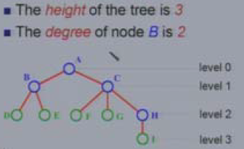
Tree
Basic Terminology-
Height -
Maximum level of any leaf in the tree.

Slide 10
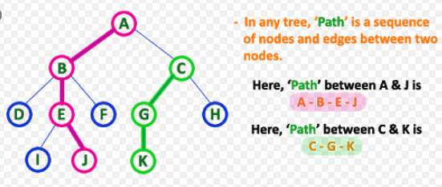
Tree
Basic Terminology-
Edge
Line drawn from one node to other
Path
Sequence of consecutive edges from the source node to the destination node

Slide 11
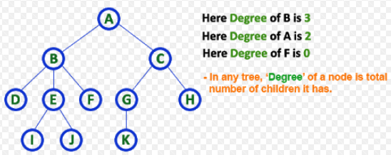
Tree
Basic Terminology-
Degree of a Node
Number of subtrees of a node in a given tree
Degree of a Tree
The maximum degree of nodes in a given tree

Slide 12
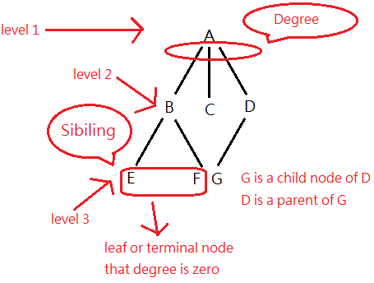
Tree
Basic Terminology-
Teminal Node/Leaf
Any node whose degree is 0
Non-Terminal Node
Any node whose degree is Non-Zero

Slide 13
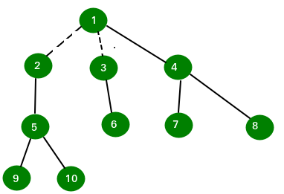
Tree
Basic Terminology-
Forest
Set of Disjoint trees,
If you remove the Root node, it becomes forest.

Slide 14
Binary Tree
A binary tree is a finite set of nodes:
It is either empty or
It consists a node called root with two disjoint binary trees-
Left subtree
Right subtree

Slide 15
Binary Tree
The Maximum degree of any node is 2
Ordered tree with all nodes having at most 2 children

Slide 16
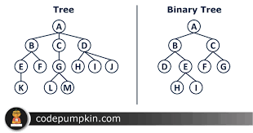
Binary Tree

Slide 17
Binary Tree
Till the discussion so far,
Linked List had 2 fields in a node-
Data field
Address field
Tree has 3 fields in a node-
Data field
Address of left child
Address of right child

Slide 18
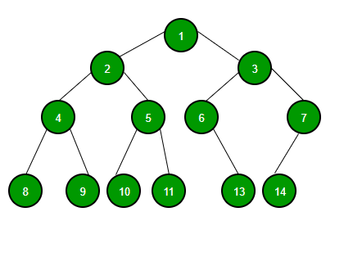
Binary Tree
Graph is used to represent tree
Every node=Circle
Line from one node to other=Edge
The beginning node is called root.

Slide 19
Traversal in Binary Tree
A tree walk or traversal is a way of visiting all the nodes in the tree in a specified order
Lets take-
N=Node
L=Left Child/Subtree
R=Right Child/Subtree

Slide 20
Traversal in Binary Tree
In traversal, we have 6 combinations-
NRL
NLR
LRN
LNR
RNL
RLN
But only 3 are standard.

Slide 21
Binary Tree Traversal Methods
Preorder
Inorder
Postorder
Level Order

Slide 22
Binary Tree Traversal Methods
A Preorder tree walk processes each node before processing its children
A Postorder tree walk processes each node after processing its children

Slide 23
Binary Tree Traversal Methods
Preorder
NLR
Visit the Root
Traverse the left subtree of root in Preorder
Traverse the right subtree of root in Preorder
Inorder
LNR
Traverse the left subtree of root in Inorder
Visit the Root
Traverse the right subtree of root in Inorder
Postorder
LRN
Traverse the left subtree of root in Postorder
Traverse the right subtree of root in Postorder
Visit the Root

Slide 24
Binary Tree Traversal Methods
We assume that we are only printing the data in a node when we visit it.

Slide 25
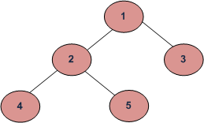
Preorder?

Slide 26
Inorder?

Slide 27
Postorder?

Slide 28
Traversal in Binary Tree
Inorder (Left, Root, Right) : 4 2 5 1 3 Preorder (Root, Left, Right) : 1 2 4 5 3 Postorder (Left, Right, Root) : 4 5 2 3 1

Slide 29
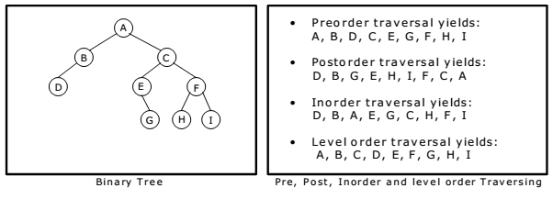
Traversal in Binary Tree
??

Slide 30
Traversal in Binary Tree

Slide 31
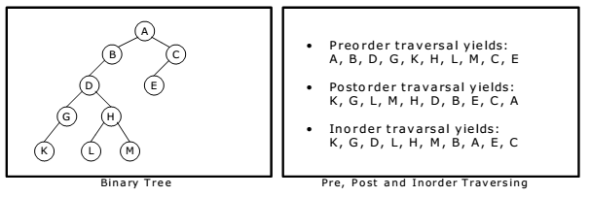
Traversal in Binary Tree
??

Slide 32
Traversal in Binary Tree

Slide 33
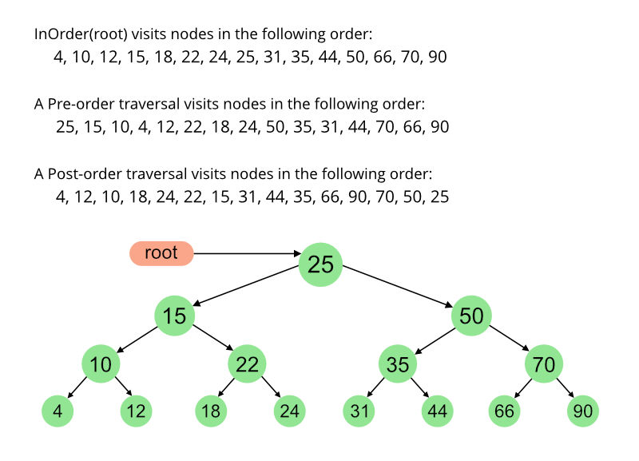
Traversal in Binary Tree

Slide 34
Traversal in Binary Tree

Slide 35
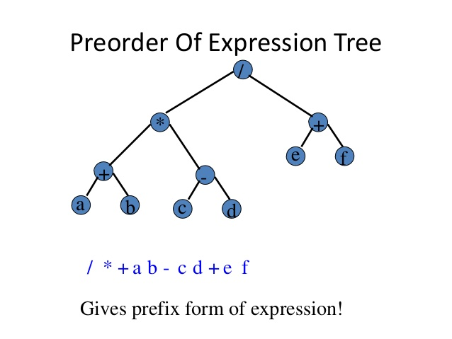
Preorder Traversal in Binary Tree –Prefix Expression

Slide 36
Preorder Traversal in Binary Tree –Prefix Expression

Slide 37
Algebraic Expression representation in tree
Any algebraic expression can be represented in binary tree
Left, Right Child=Operand of the expression
Parent of the child=Operator

Slide 38
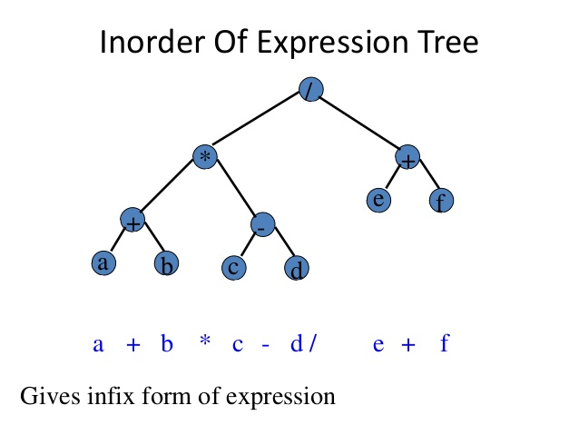
Inorder Traversal in Binary Tree –Infix Expression

Slide 39
Inorder Traversal in Binary Tree –Infix Expression

Slide 40
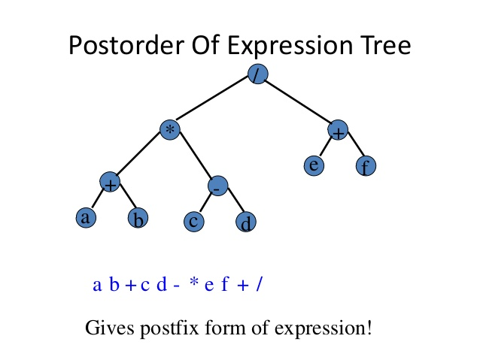
Postorder Traversal in Binary Tree –Postfix Expression

Slide 41
Postorder Traversal in Binary Tree –Postfix Expression

Slide 42
Level order Traversal in Binary Tree
We traverse the nodes according to their levels.
Traverse Level 0
Then Traverse all the nodes of Level 1
Then Traverse all the nodes of Level 2
And so on…..
Traverse the nodes of a particular level from Left to Right

Slide 43
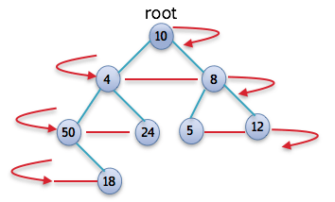
Level order Traversal in Binary Tree
Level Order Traversal=10, 4, 8, 50, 24, 5, 12 and 18.

Slide 44
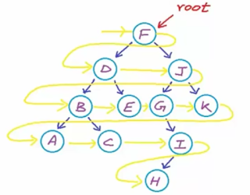
Level order Traversal in Binary Tree
Level Order Traversal=F, D, J, B, E, G, K, A, C I, H

Slide 45
Types of Binary Trees-
Binary trees can be of the following types-
Rooted Binary Tree/Simple Binary Tree
Full / Strictly Binary Tree
Complete / Perfect Binary Tree

Slide 46
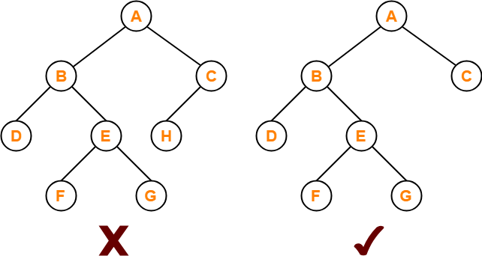
Strictly Binary Tree
Strict
If every node is either a Leaf or has 2 children
Also called Full binary tree

Slide 47
Strictly Binary Tree
A strictly Binary tree with n leaf nodes always contains 2n-1 total no of Nodes
no of leaves=4
2n-1=7
no of leaves=4
2n-1=7

Slide 48
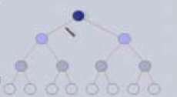
Completely Binary Tree
In a CBT tree of height h, All whose leaves are at Level h

Slide 49
Completely Binary Tree
No of nodes at Level 0=2⁰
No of nodes at Level 1=2¹
No of nodes at level 2=2²
|
|
|
No of nodes at level h=2^{h}

Slide 50

Completely Binary Tree
No of nodes at Level 0=2⁰
No of nodes at Level 1=2¹
No of nodes at level 2=2²
|
|
|
No of nodes at level h=2^{h}
Total Number of nodes in a complete Binary Tree of depth h=2⁰+2¹+2²+ ---------2^{h}
⁼2^{h+1}-1
Using Sum of Geometric Progression Series-

Slide 51
Completely Binary Tree
Let the total nodes in tree =n, then
n=2^{h+1}-1
2^{h+1}=n+1
Using log:
log₂(n+1)=h+1
log₂(n+1)-1=h
i.e. Height=h=log₂(n+1)-1
Height & No of Nodes

Slide 52
Completely Binary Tree
In Complete Binary Tree, no of leaves=(n+1)/2
n=total no of nodes
n=15
no of leaves=16/2=8

Slide 53
Completely Binary Tree
Let the total nodes in tree =n, then
n=2^{h+1}-1
2^{h+1}=n+1
2^{h}*2=n+1
2^{h}=(n+1)/2
In Complete Binary Tree, no of leaves=(n+1)/2
Thus,
h=log₂(n+1)/2
Height=h=log₂(No of leaves)
Height & No of Leaves

Slide 54
Completely Binary Tree
No of internal nodes=no of leaves-1
No of leaves=8
No of Internal Nodes=8-1=7

Slide 55
Completely Binary Tree
Level I has 2^{i} nodes
So at level h, no of nodes= 2^{h}
No of leaves=2^{h}
No of internal node=2⁰+2¹+2²+…….+2^{h-1}=2^{h}-1
Using Sum of Geometric Progression Series-
No of internal nodes=no of leaves-1

Slide 56

Complete Binary Tree
A binary tree can be obtained from an complete binary tree by pruning
Take a complete binary tree, cut off some branches then you will get a binary tree.

Slide 57
Representation of a Binary Tree
Array Representation
Linked List Representation

Slide 58
Array Representation of a Binary Tree
Using 1-D Array
Nodes are numbered sequentially level by level left to right.
Even empty nodes are numbered
When data of the tree is stored in an array then the number appearing against the node will work as indices of the node in the array

Slide 59
Array Representation of a Binary Tree
A
B
D
E
C
F
G
H
I
[0] | [1] | [2] | [3] | [4] | [5] | [6] | [7] | [8]
A | B | C | D | E | F | G | H | I

Slide 60
Array Representation of a Binary Tree
A
B
C
D
E
F
G
[0] | [1] | [2] | [3] | [4] | [5] | [6] | [7] | [8] | [9] | [10] | [11] | [12]
A | B | C |  |  | D | E |  |  |  |  | F | G

Slide 61
Array Representation of a Binary Tree
A
B
D
E
C
F
G
H
I
[0] | [1] | [2] | [3] | [4] | [5] | [6] | [7] | [8]
A | B | C | D | E | F | G | H | I
Node in position p
Is the implicit father of nodes 2p+1 and 2p+2
Left child=2p+1
Right child=2p+2

Slide 62
Array Representation of a Binary Tree
A
B
D
E
C
F
G
H
I
[0] | [1] | [2] | [3] | [4] | [5] | [6] | [7] | [8]
A | B | C | D | E | F | G | H | I
Given a Left child at position p then
Right brother=p+1
Given a Right child at position p then
Left brother=p-1

Slide 63
Linked Representation of Binary Trees
Recursive functions for Traversal in Binary Tree

Slide 64
Structure for Binary Tree Node
struct node
{
int num;
struct node *left;
struct node *right;
};

Slide 65
Preorder Traversal in Binary Search Tree
void preorder(struct node *tree)
{
if(tree!=NULL)
{
printf("%d\n",tree->num);
preorder(tree->left);
preorder(tree->right);
}
}

Slide 66
Inorder Traversal in Binary Search Tree
void inorder(struct node *tree)
{
if(tree!=NULL)
{
inorder(tree->left);
printf("%d\n",tree->num);
inorder(tree->right);
}
}

Slide 67
Postorder Traversal in Binary Search Tree
void postorder(struct node *tree)
{
if(tree!=NULL)
{
postorder(tree->left);
postorder(tree->right);
printf("%d\n",tree->num);
}
}

Slide 68
Binary Tree Construction

Slide 69
Binary Tree Construction
Can you construct Binary Tree , Given two traversals

Slide 70
Binary Tree Construction
Can you construct Binary Tree , Given two traversals
Yes

Slide 71
Binary Tree Construction
Depends on which 2 sequences are given
Can be constructed , the following combination is given-
Preorder + Inorder
or
Postorder + Inorder

Slide 72
Binary Tree Construction
Usage-
Preorder/Postorder= To find out the root
Inorder=To find the left and right subtree/child

Slide 73
Binary Tree Construction=In+PostOrder

Slide 74
Binary Tree Construction=In+PostOrder
Postorder=LRN
Postorder=HDIEBJFKLGCA
Inorder=HDBIEAFJCKGL

Slide 75
Binary Tree Construction=In+PostOrder
Postorder=LRN
Postorder=HDIEBJFKLGCA
Inorder=HDBIEAFJCKGL

Slide 76


Binary Tree Construction=In+PostOrder
Postorder=LRN
Postorder=HDIEBJFKLGCA
Inorder=HDBIEAFJCKGL
In Postorder traversal, The Last Node is the Root. So, A is the Root Node
From Inorder traversal,
Inorder=HDBIEAFJCKGL
Left subtree=Nodes on Left of the Node=HDBIE
Right subtree=Nodes on the Right of the node=FJCKGL
Left Subtree
Right Subtree

Slide 77
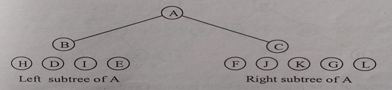
Binary Tree Construction=In+PostOrder
Postorder=HDIEBJFKLGCA
Inorder=HDBIEAFJCKGL
In Postorder traversal,
HDIEB JFKLGC A
Now Right child of A will be the node which comes just before node A.
C is the right child
Left child of A will be the first node before nodes of right subtree in postorder traversal.
B is the left child
Left Subtree
Right Subtree

Slide 78
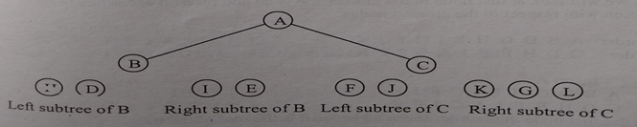
Binary Tree Construction=In+PostOrder
Postorder=HDIEBJFKLGCA
Inorder=HDBIEAFJCKGL
Now Look at C in InOrder Traversal , Inorder=HDBIEAFJCKGL
So for C
Left subtree=FJ
Right subtree=KGL
Now Look at B in InOrder Traversal , Inorder=HDBIEAFJCKGL
So for B
Left subtree=HD
Right subtree=IE
Left Subtree
Right Subtree
Left Subtree
Right Subtree

Slide 79
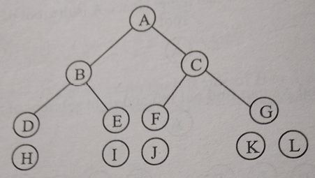
Binary Tree Construction=In+PostOrder
Postorder=HDIEBJFKLGCA
Inorder=HDBIEAFJCKGL
Now Look at node just before B in PostOrder Traversal ,
Postorder=HDIEBJFKLGCA
E is right child
Left child of A will be the first node before nodes of right subtree in postorder traversal.
D is the left child
Left Subtree
Right Subtree

Slide 80
Binary Tree Construction=In+PostOrder
Postorder=HDIEBJFKLGCA
Inorder=HDBIEAFJCKGL
Now Look at node just before C in PostOrder Traversal ,
Postorder=HDIEBJFKLGCA
G is right child
Left child of C will be the first node before nodes of right subtree in postorder traversal.
F is the left child
Left Subtree
Right Subtree

Slide 81
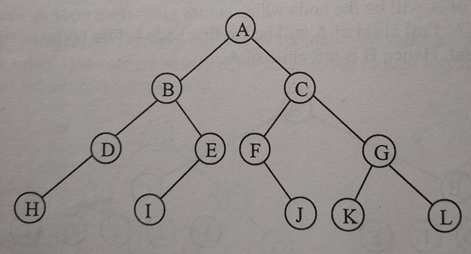
Binary Tree Construction=In+PostOrder
Postorder=LRN
Postorder=HDIEBJFKLGCA
Inorder=HDBIEAFJCKGL
From Inorder traversal,
H is to the left of D so
Left child of D =H
I is to the Left of E
Left child of E =I
From Inorder traversal,
J is to the right of F so
Right child of F =J
K is to the Left of G
L is to the right of G
Left child of G =K
Right child of G =L

Slide 82
Binary Tree Construction=In+PreOrder

Slide 83

Binary Tree Construction=In+PreOrder

Slide 84
Binary Tree Construction=In+PreOrder

Slide 85
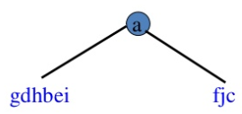
Binary Tree Construction=In+PreOrder
Preorder=NLR
In Preorder traversal, The First Node is the Root.
From Inorder traversal-Find the left subtree and right subtree
Nodes on the left of the root in Inorder =Left Subtree
Nodes on the right of the root in Inorder =Right Subtree

Slide 86
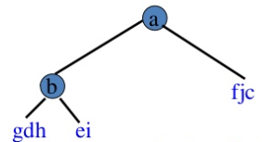
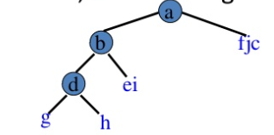
Binary Tree Construction=In+PreOrder
Preorder=bdgheicfj
Inorder=gdh b ei a fjc
b is the next root
Left subtree=gdh
Right Subtree=ei
Preorder=dgheicfj
Inorder=gdh b ei a fjc
d is the next root
g is on left of d
Left subtree=g
h is on right of d
Right Subtree=h

Slide 87
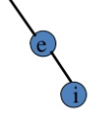
Binary Tree Construction=In+PreOrder
Preorder=eicfj
Inorder=gdh b ei a fjc
e is the next root
Left subtree=NULL
Right Subtree=i
Preorder=cfj
Inorder=gdh b ei a fjc
c is the next root
Left subtree=fj
Right Subtree=NULL

Slide 88

Binary Tree Construction=In+PreOrder
Preorder=fj
Inorder=gdh b ei a fjc
f is the next root
Left subtree=NULL
Right Subtree=j
Done

Slide 89
Can Binary Tree be constructed using Preorder + Postorder Traversals?

Slide 90
Can Binary Tree be constructed using Preorder + Postorder Traversals?No Why?? Any Guesses?

Slide 91

Binary Tree Construction
Given the Preorder and Postorder traversal of binary tree, we cannot uniquely identify the tree.
This is because there can be two trees, with the same preorder and postorder traversals

Slide 92
Binary Tree Construction
Construct the Binary Tree corresponding to the following traversals
inOrder = { 4, 2, 5, 1, 6, 3, 7 }
postOrder = { 4, 5, 2, 6, 7, 3, 1 }

Slide 93
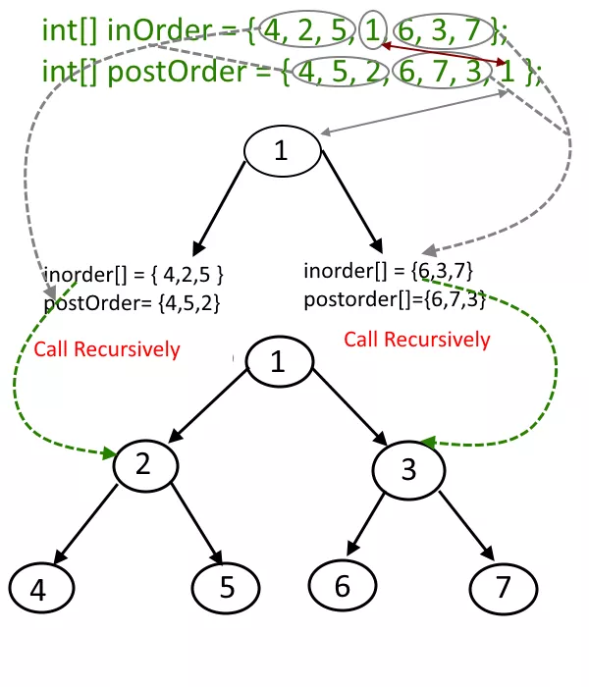
Binary Tree Construction
Construct the Binary Tree corresponding to the following traversals
inOrder = { 4, 2, 5, 1, 6, 3, 7 }
postOrder = { 4, 5, 2, 6, 7, 3, 1 }

Slide 94
Binary Tree Construction
Construct the Binary Tree corresponding to the following traversals

Slide 95
Binary Tree Construction
Construct the Binary Tree corresponding to the following traversals

Slide 96
Binary Search Tree

Slide 97
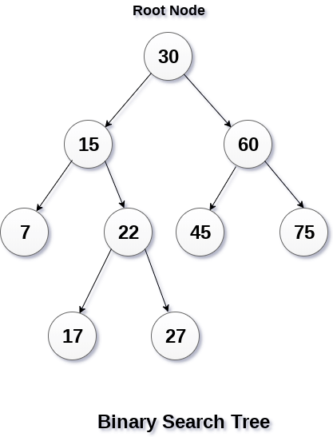
Binary Search Tree
A Binary tree which is either empty or satisfies the following rules-
The value of the key in the left child or left subtree is less than the value of the root.
The value of the key in the right child or right subtree is more than the value of the root
All the subtrees of the left and right children observe the two rules.
There must be no duplicate nodes

Slide 98
Binary Search Tree
Why? Such Ordering?

Slide 99
Binary Search Tree
The above properties of Binary Search Tree provide an ordering among keys so that the operations like
search,
minimum and
maximum
can be done fast.
If there is no ordering, then we may have to compare every key to search a given key.

Slide 100
Create the binary search tree using data elements.

Slide 101
Create the binary search tree using data elements.
43, 10, 79, 90, 12, 54, 11, 9, 50
Insert 43 into the tree as the root of the tree.
Read the next element, if it is lesser than the root node element, insert it as the root of the left sub-tree.
Otherwise, insert it as the root of the right of the right sub-tree.
Continue……

Slide 102
Create the binary search tree using data elements.
43, 10, 79, 90, 12, 54, 11, 9, 50

Slide 103
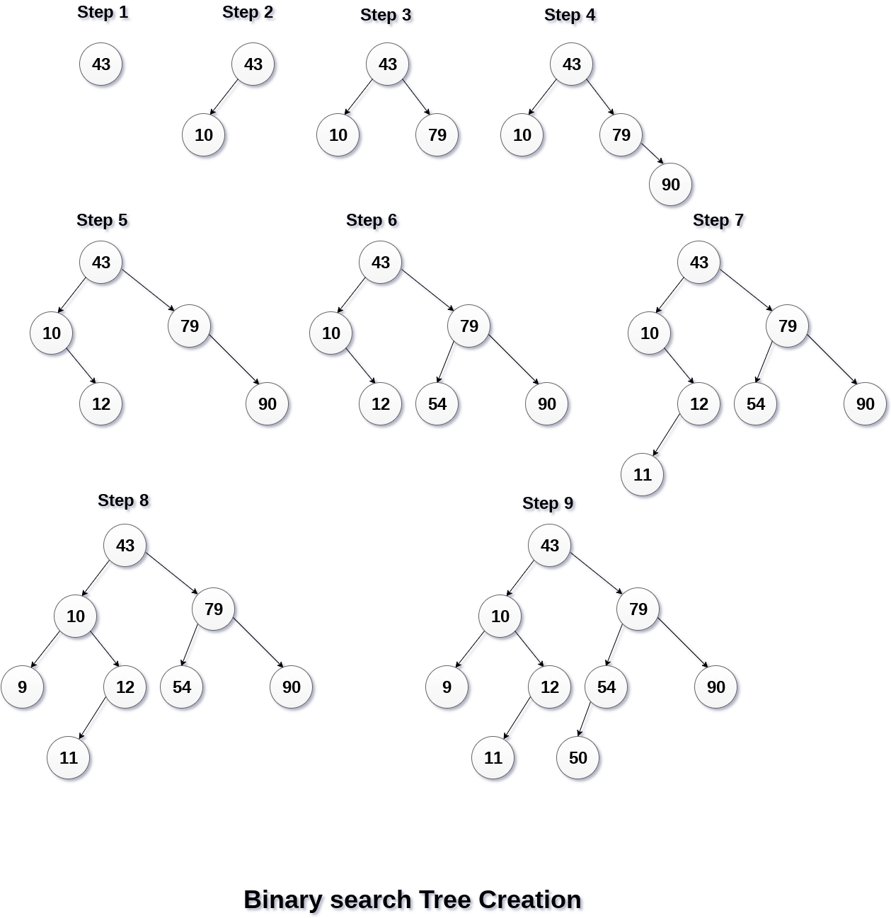
Create the binary search tree using data elements.
43, 10, 79, 90, 12, 54, 11, 9, 50

Slide 104
Create the binary search tree using data elements.
https://austingwalters.com/wp-content/uploads/2014/10/binary-tree-1-creation.gif

Slide 105
Create the binary search tree using data elements.
10,12,5,4,20,8,7,15 and 13
??

Slide 106
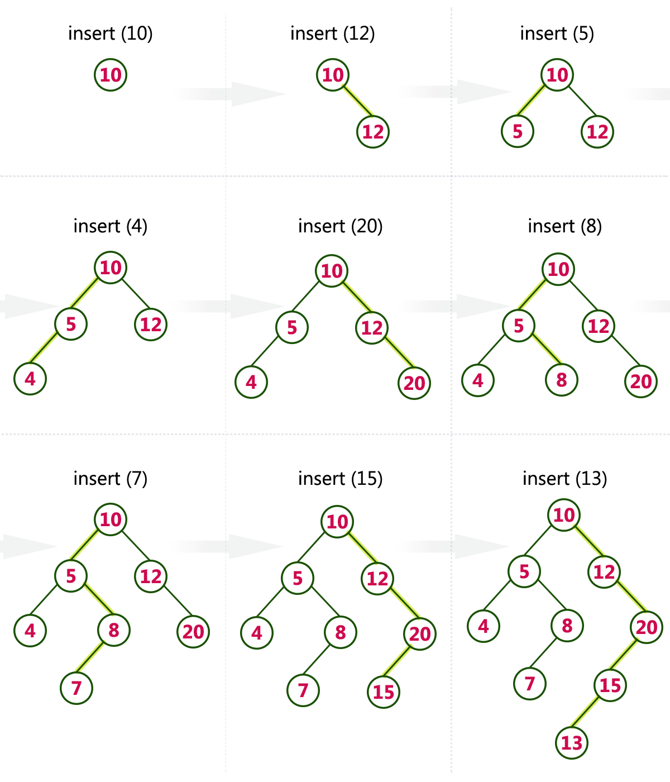
Create the binary search tree using data elements.
10,12,5,4,20,8,7,15 and 13

Slide 107
Searching and Insertion Operation in Binary Search Tree
Before Insertion of any element , we first search the exact place for inserting

Slide 108
Searching and Insertion Operation in Binary Search Tree
The steps are-
Compare the data with the root node
If the data<data of node compare with data of left child
If the data>data of node compare with data of right child
At last , we will reach the exact place where we will insert the data.

Slide 109
Q)Suppose the numbers 7, 5, 1, 8, 3, 6, 0, 9, 4, 2 are inserted in that order into an initially empty binary search tree. The binary search tree uses the usual ordering on natural numbers. What is the in-order traversal sequence of the resultant tree?
(A) 7 5 1 0 3 2 4 6 8 9 (B) 0 2 4 3 1 6 5 9 8 7 (C) 0 1 2 3 4 5 6 7 8 9 (D) 9 8 6 4 2 3 0 1 5 7

Slide 110
Q)Suppose the numbers 7, 5, 1, 8, 3, 6, 0, 9, 4, 2 are inserted in that order into an initially empty binary search tree. The binary search tree uses the usual ordering on natural numbers. What is the in-order traversal sequence of the resultant tree?
(A) 7 5 1 0 3 2 4 6 8 9 (B) 0 2 4 3 1 6 5 9 8 7 (C) 0 1 2 3 4 5 6 7 8 9 (D) 9 8 6 4 2 3 0 1 5 7 Answer: (C) Explanation: In-order traversal of a BST gives elements in increasing order. So answer c is correct without any doubt.

Slide 111
Traversal in Binary Search Tree
Traversal in Binary Search Tree is same as Traversal in Binary tree
Preorder
Postorder
Inorder

Slide 112
Traversal in Binary Search Tree
Some Interesting Facts:
Inorder traversal of BST always produces sorted output.
We can construct a BST with only Preorder or Postorder or Level Order traversal.
Note that we can always get inorder traversal by sorting the only given traversal.

Slide 113
Traversal in Binary Search Tree
Lets check
Inorder Traversal-
9,10,11,12,43,50,54,79,90
Yes, Sorted!!!!

Slide 114
Delete Operation in Binary Search Tree
Complex than insertion and searching
There are 3 cases-
Case 1- Node is a leaf node
Case 2- Node has exactly one child node
Case 3- Node has exactly two child nodes

Slide 115
Delete Operation in Binary Search Tree
Case 1- Node is a leaf node
If a node is a leaf node, it has no children
Simply delete it
by giving NULL value to its Parent’s
right pointer or
left pointer

Slide 116
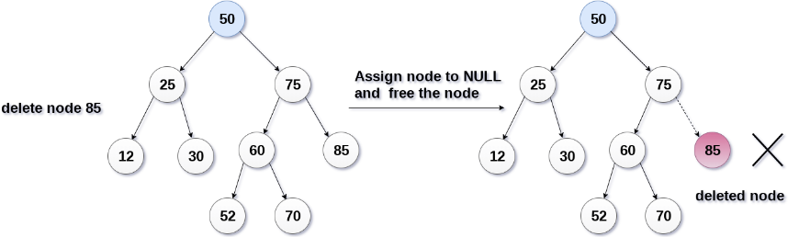
Delete Operation in Binary Search Tree
Case 1- Node is a leaf node

Slide 117

Delete Operation in Binary Search Tree
Case 2- Node has exactly one child node
Copy the child to the node and delete the child

Slide 118
Delete Operation in Binary Search Tree
Case 3- Node has exactly two child nodes
Find the inorder successor of the item
Copy contents of the inorder successor to the node
Delete the inorder successor.
Note that inorder predecessor can also be used.

Slide 119
Delete Operation in Binary Search Tree
Find the inorder successor of the item
Use the Inorder traversal

Slide 120

Delete Operation in Binary Search Tree
Case 3- Node has exactly two child nodes

Slide 121
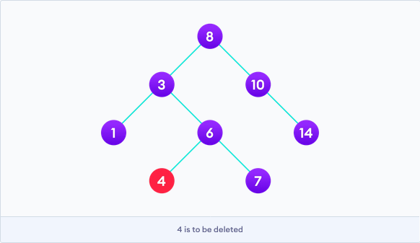
Delete the following nodes from the BST
4
6
In sequence

Slide 122
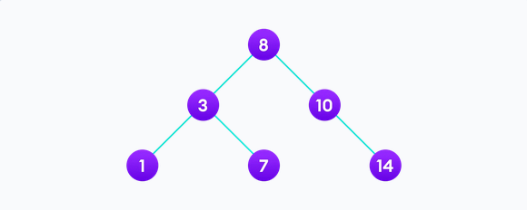
Delete the following nodes from the BST
4
6
In sequence

Slide 123
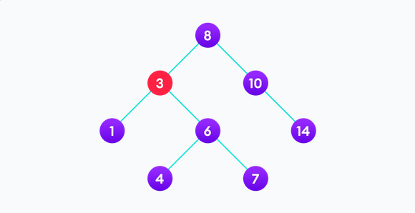
Delete the following nodes from the BST
3

Slide 124
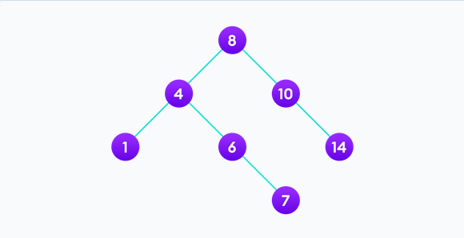
Delete the following nodes from the BST
3

Slide 125
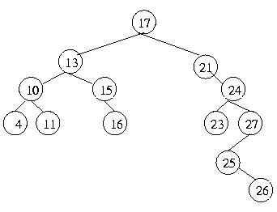
Delete Operation in Binary Search Tree
Consider the given BST and perform the following operations in sequential manner:
Delete 4
Delete 10
Delete 27
Delete 13

Slide 126
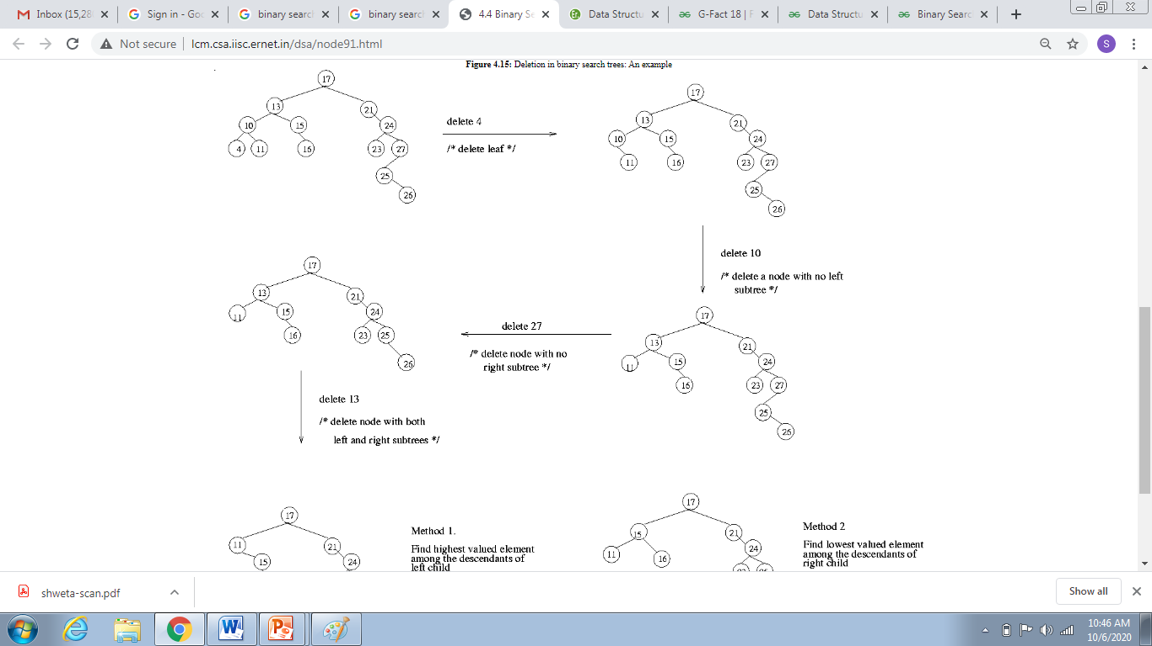
Delete Operation in Binary Search Tree

Slide 127
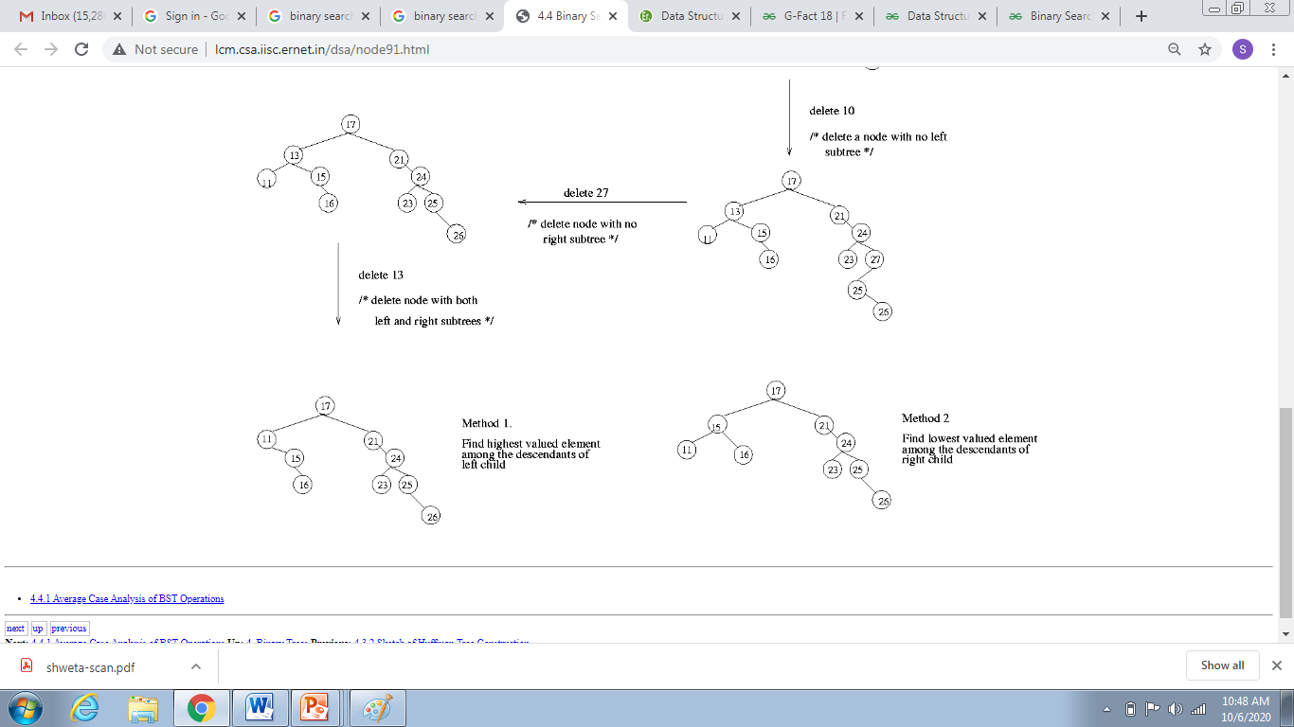
Delete Operation in Binary Search Tree
http://lcm.csa.iisc.ernet.in/dsa/node91.html

Slide 128
Q)The preorder traversal sequence of a binary search tree is 30, 20, 10, 15, 25, 23, 39, 35, 42. Which one of the following is the postorder traversal sequence of the same tree? (A) 10, 20, 15, 23, 25, 35, 42, 39, 30 (B) 15, 10, 25, 23, 20, 42, 35, 39, 30 (C) 15, 20, 10, 23, 25, 42, 35, 39, 30 (D) 15, 10, 23, 25, 20, 35, 42, 39, 30

Slide 129
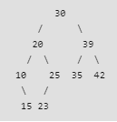
Q)The preorder traversal sequence of a binary search tree is 30, 20, 10, 15, 25, 23, 39, 35, 42. Which one of the following is the postorder traversal sequence of the same tree? (A) 10, 20, 15, 23, 25, 35, 42, 39, 30 (B) 15, 10, 25, 23, 20, 42, 35, 39, 30 (C) 15, 20, 10, 23, 25, 42, 35, 39, 30 (D) 15, 10, 23, 25, 20, 35, 42, 39, 30 Answer: (D) Explanation:
Sort the preorder to get the Inorder Traversal, then construct the tree
The following is the constructed tree

Slide 130
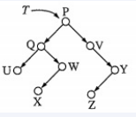
ISRO | ISRO CS 2014 | Question 41
Consider the following binary search tree T given below: Which node contains the fourth smallest element in T?
(A) Q (B) V (C) W (D) X

Slide 131
ISRO | ISRO CS 2014 | Question 41
Consider the following binary search tree T given below: Which node contains the fourth smallest element in T?
(A) Q (B) V (C) W (D) X Answer: (C)
Inorder Traversal=UQXWPVZY
Is in sorted order , so ans=W

Slide 132
ISRO | ISRO CS 2009 | Question 26
The following numbers are inserted into an empty binary search tree in the given order: 10, 1, 3, 5, 15, 12, 16. What is the height of the binary search tree (the height is the maximum distance of a leaf node from the root)? (A) 2 (B) 3 (C) 4 (D) 6

Slide 133
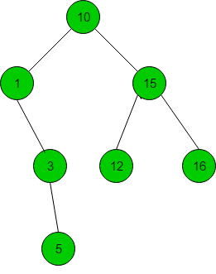
ISRO | ISRO CS 2009 | Question 26
The following numbers are inserted into an empty binary search tree in the given order: 10, 1, 3, 5, 15, 12, 16. What is the height of the binary search tree (the height is the maximum distance of a leaf node from the root)? (A) 2 (B) 3 (C) 4 (D) 6
Answer: (B) Explanation:
So, height of the tree is 3, option (B) is correct.

Slide 134
Binary search Tree Implementation
struct node
{
int num;
struct node *left;
struct node *right;
};

Slide 135
Insertion in Binary Search Tree
struct node *insert(struct node *tree,int digit)
{
if(tree==NULL)
{
tree=(struct node *)malloc(sizeof(struct node));
tree->left=tree->right=NULL;
tree->num=digit;
}
else
if(digit<tree->num)
tree->left=insert(tree->left,digit);
else
if(digit>tree->num)
tree->right=insert(tree->right,digit);
else if(digit==tree->num)
{
printf("Duplicate node:program exited");
exit(0);
}
return(tree);
}

Slide 136
Search in Binary Search Tree
void search(struct node *tree,int digit)
{
if(tree==NULL)
printf("The number does not exits\n");
else
if(digit==tree->num)
printf("Number=%d\n" ,digit);
else
if(digit<tree->num)
search(tree->left,digit);
else
search(tree->right,digit);
}

